Slide 1
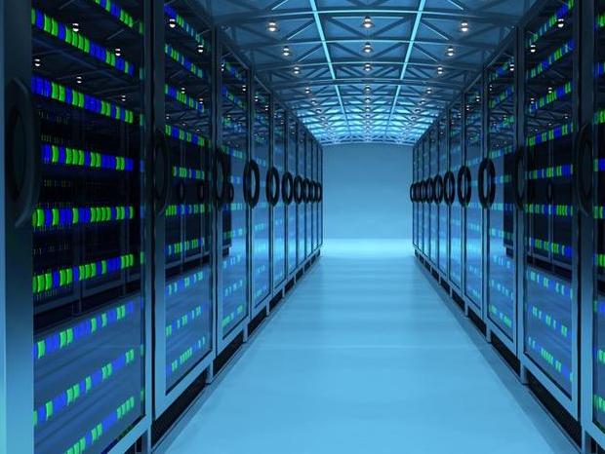
Building Data Center Ztrip – Ride Hailing Service
Ankit Sharma
Itm 315 infrastructure and hosted services
Prof. Michael Lombardo
Spring 2018

Slide 2
INDEX
About Ztrip – Ride Sharing
States with Tax Benefits for Data Center
Why Oregon?
Why going with Raised Floor?
Components of Data Center
Structured Cabling
Data Center Floor Plan
Cooling Mechanism For the Data Center
Green Approach for Cooling Data Center – Free Cooling
Risk Assessment for Cooling Redundancy

Slide 3
Ztrip – Ride Sharing
Ztrip is an ride sharing and transportation network company
Private Company – Headquartered in Prineville, Oregon
Business operated all over the United States
One of the leader in Sharing Economy
Competitors Uber and Lyfts
Company stores critical data for their customers, drivers and Employees
Centralized Website
Works on all Smartphones and Tablet platforms
Enterprise Applications such as ERP and CRM
Company vision for building data center
Preferred cheap rates for electricity and tax break
Tier 4 - Need High Availability for the data center
99.995 % uptime with N+1 redundancy.
Plan to Build – 3000 Sq. Ft Server Room

Slide 4
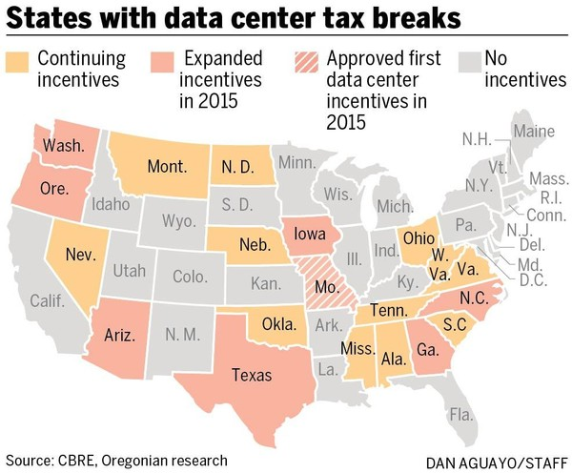
States with Tax Benefits for Data Center

Slide 5
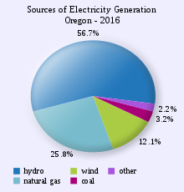
Why Oregon?
Oregon is the third largest renewable energy producing state in the United States
Building data center in Prineville, Oregon
Mild Climate – Naturally Available Cool Air and Low Humidity
Suitable for Installing Airside Economizer – Free Cooling
Average Industrial Electricity Rate
Cheap Electricity – 6.68(Cents per kWh)
No state sales tax for data centers
Renewable Sources of Energy available
Wind
Solar
Hydro

Slide 6
Why going with Raised Floor?
For large and mid-size data center
Provides dedicated space for cooling channel
Good airflow management
Compatible with cooling infrastructure
Flexibility for future expansion
Hides patch cords and power cables
Looks professional and less cluttered
Reduce damage of accidental unplug
Cabling easily accessible under the floor
Free from climbing a step ladder
Downside
Initial upfront cost
Careful arrangement of floor tiles

Slide 7
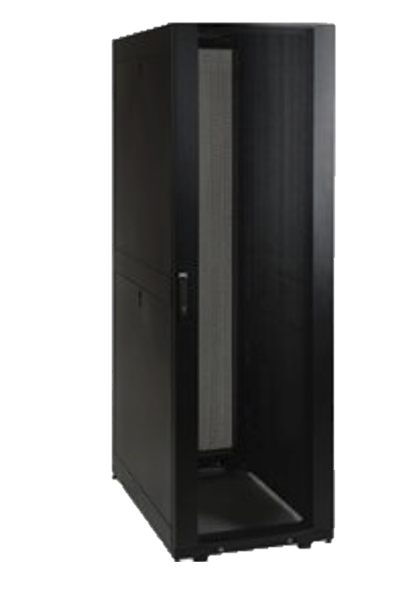
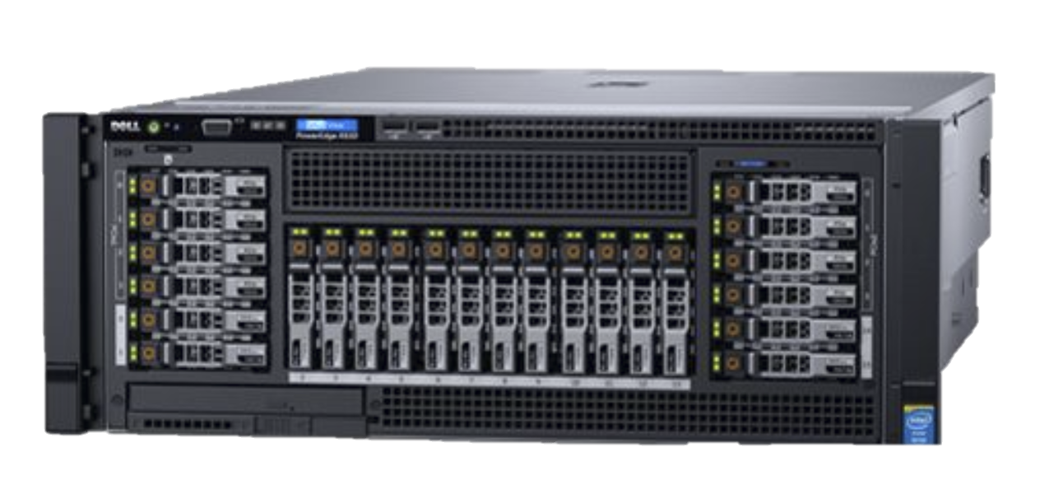
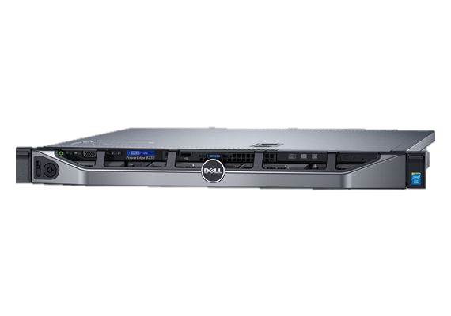
Components of Data Center
Server Racks: Rack Cabinet
Dell - TrippLite Smart Rack 42-Units Enclosure
Compatible with 19-inch rack equipment
5-year warranty
60 Cabinets
Server: Application Server – 4U & 1U
Dell - PowerEdge R930 & R230 Rack Server
2.5" Chassis with up to 4 Hard Drives
OS – Linux Ubuntu Server Addition
CPU - 2x Intel Xeon E7-8870 v3
Ram – 8 GB DDR5 ,2400 Ghz
HDD - 960GB SSD

Slide 8
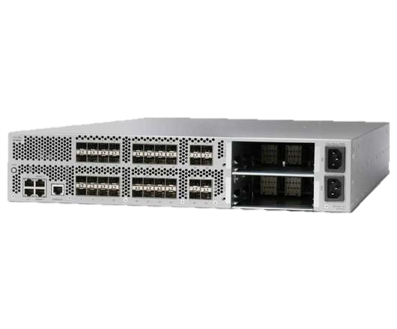
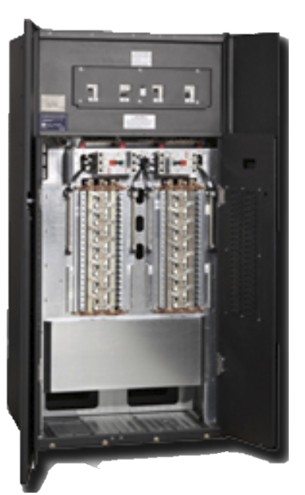
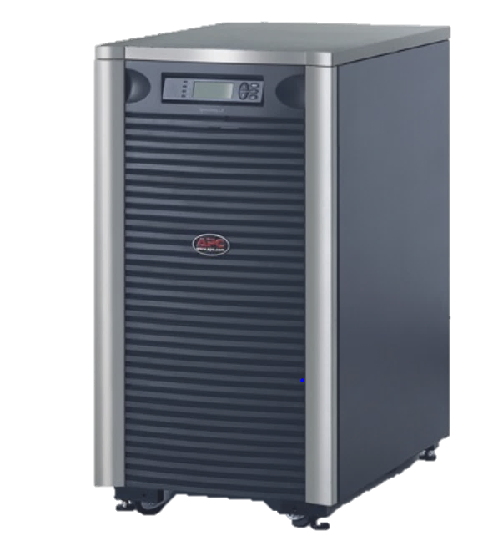
Switch - Cisco Nexus 5020
40 Port 10 Gigabit Ethernet Switch
Power Distribution Units (PDUs)
Eaton Power Distribution Unit (PDU)
Integrated isolation, monitoring and distribution
Comprehensive monitoring and connectivity options
UPS - APC Symmetra LX 12kVA
Scalable Up to 16kVA N+1 Power
User Replaceable Batteries
Predictive power Failure Notification
Secure shutdown

Slide 9
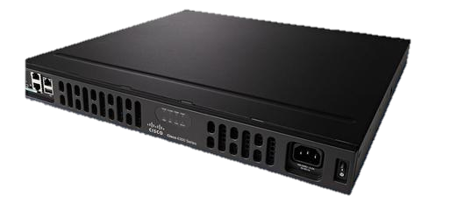
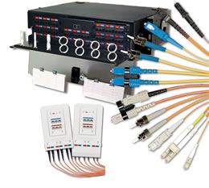
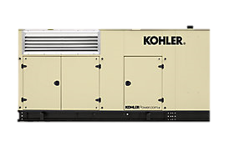
Router
Cisco CISCO1921/k9 Series Integrated Routers
Cables
Copper
TERA Category 7A - Twisted Pair Copper Cables
Speeds up to to 10Gb/s
Fiber optic Cabling
XGLO Fiber Optic Cabling System
Speeds more than 10Gb/s
Generator
Kohler – 400RE0ZJB, 60 HZ
Diesel Generator

Slide 10
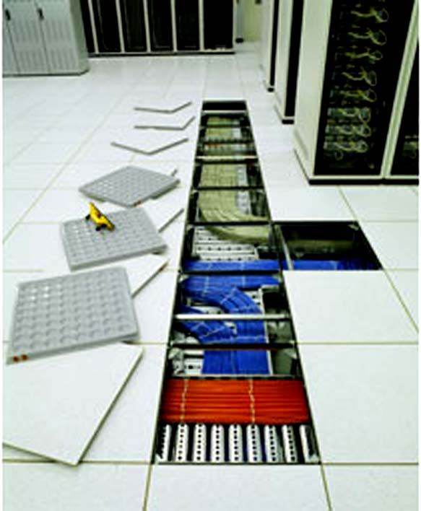
Structured Cabling
Under the floors installation with Raised Floor
Power Cables
Data Cabling
Cooling
Electrical conduits running from Two Different PDU to the circuit panels for power redundancy.
Each Server Cabinets
Two Electrical Circuits and two power strips
Networking
Fiber - Used 24 strands(12 Ports) of 50 Mm multimode Fiber
Copper - 24 Ports of Category 7A copper
Color Coded and Labelled wiring
Tested with TIA/EIA 568 wiring standards
Notes:
We will be using structured cabling with distributed power source for our data center to provide power redundancy
For under the floor installation with raised floor we can install power cables , data cabling and cooling all under the raised floor installation.
We have also run electrical conduits from two different PDUs so load is divided by 50-50% on each PDU and is running to to the circut panel for power redundancy
In other words, we have each server cabinets with two electrical circuit breakers and two power strips and for networking we have used fiber cable with 24 strands of 50 Mm multimode fiber and copper with 24 ports of category 7a copper
Which are colour coded and labelled wiring with are tested with TIA.EIA 568 wiring standards.

Slide 11

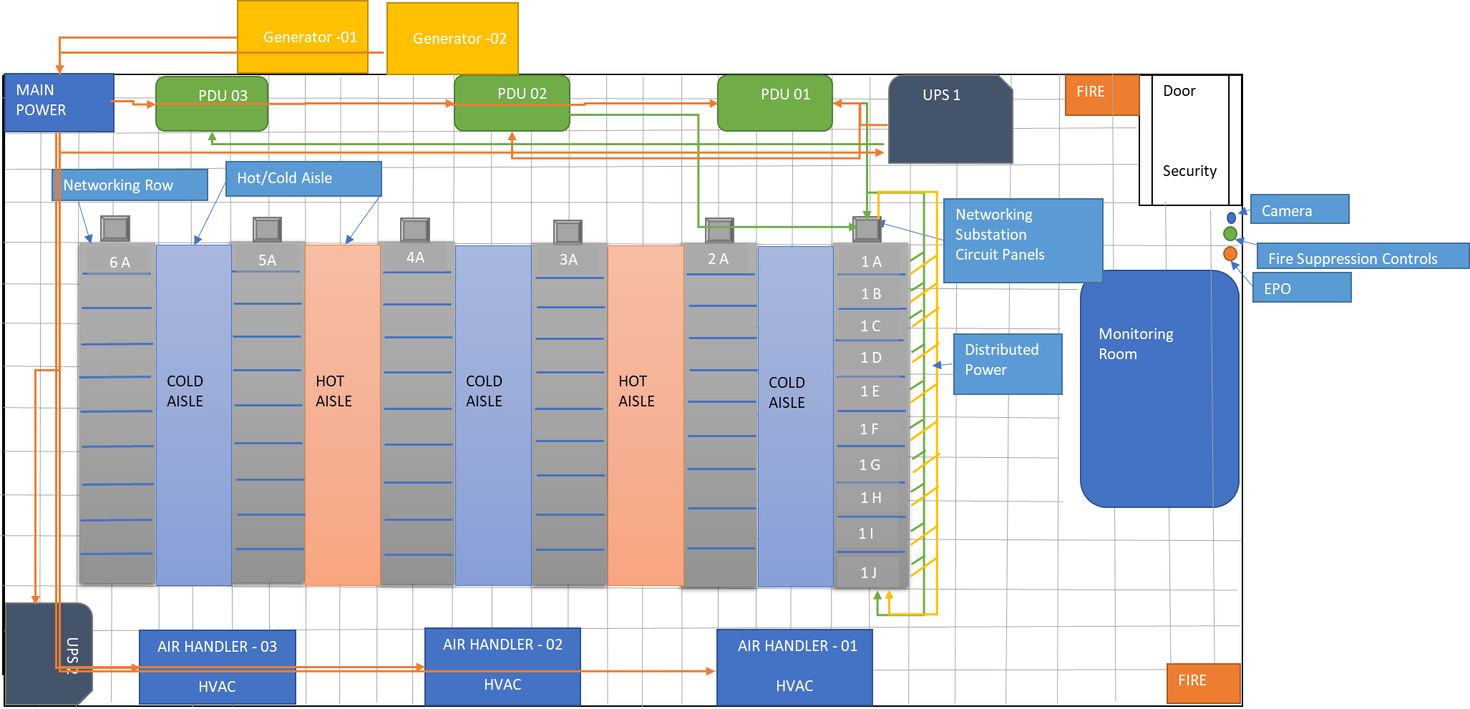
Data Center Floor Plan

Slide 12
Cooling Mechanism For the Data Center
For Raised Floor Data Center
Chilled Water Cooling Method
Air Side Economizer – Free Cooling
Reduces use of Refrigeration Compressor
Cooling Redundancy
Used 3 Air Handlers Units
Main Power Connection for Air Handler
Used Separate UPS & Generator Backup for HVAC, Servers and Networking Devices

Slide 13
Green Approach for Cooling Data Center – Free Cooling
Computer Room Air Handler Units (CRAH)
Compatible with Airside Economizers
Uses both outside air and chilled water for cooling
60 % Reduce Annual Electricity Consumption
15% Reduction in PUE
Reasons for going green with Cooling Infrastructure
Favorable climatic conditions for using natural air for cooling
Installing Airside Economizer in new data center facility will be feasible
Industrial Electricity is cheaper - 6.68(Cents per kWh)

Slide 14
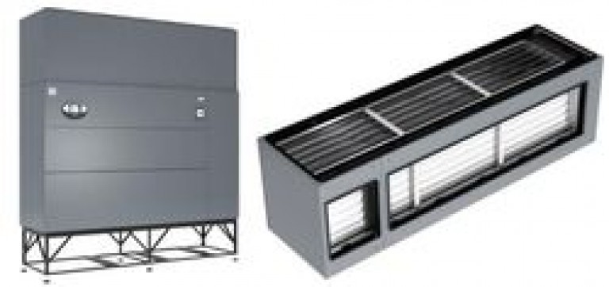
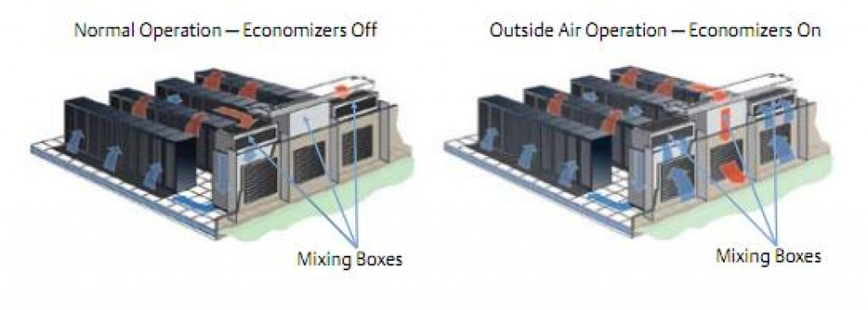
Air Side Economizer

Slide 15
Risk Assessment for Cooling Redundancy
Freezing can occur once the ambient air temperature gets below 0 °C.
Full free cooling and mixed operation starts at relatively low outdoor air temperatures.
May be maintenance intensive
Not applicable in all regions

Slide 16
References
Rogoway, M. (2018, Januarary 19). Data centers' small-town tax breaks bring Silicon Valley to rural America Retrieved from http://www.oregonlive.com/silicon-forest/index.ssf/2015/10/small-town_tax_breaks_bring_si.html
Rareshide, M. (2017, October 23). Power in the Data Center and its Cost Across the U.S. Retrieved from https://info.siteselectiongroup.com/blog/power-in-the-data-center-and-its-costs-across-the-united-states
Rogoway, M. (2011, November 19). Data centers in Oregon: High tech meets high desert (part 1 of 3) Retrieved from http://www.oregonlive.com/business/index.ssf/2011/11/data_clouds_settle_in_oregon_w.html
Energy in Oregon (n.d.) Retrieved from https://en.wikipedia.org/wiki/Energy_in_Oregon
Cisco Nexus 5000 Series Switches.(n.d.). Retrieved from https://www.cisco.com/c/en/us/products/switches/nexus-5000-series-switches/index.html
Copper Cabling Solutions for Data Centers. Retrieved from http://www.siemon.com/us/datacenter/cabling/copper.aspx
TrippLite SmartRack 42-Units Premium Enclosure. Retrieved from http://www.dell.com/en-us/work/shop/accessories/apd/a0688999?cid=302824&st=&gclid=Cj0KCQjw-uzVBRDkARIsALkZAdm-XgN52J7m9voX7E
Cisco Nexus 5000 Series(n.d.). Retrieved from http://www.router-switch.com/n5k-c5548up-fa.html?gclid=Cj0KCQjw-uzVBRDkARIsALkZAdnLKQ9oTOY9_QLuEfjouGKzLSaCzppRp0bLlwcQshdIzK4NHr9RGEAaAqMeEALw_wcB
Captial cost calculator(n.d.). Retrieved from https://www.schneider-electric.com/en/work/solutions/system/s1/data-center-and-network-systems/trade-off-tools/data-center-capital-cost-calculator/

